Slide 1
Bayesian Modeling in Oncology Trials
Part 3: Statistical Considerations for Master Protocols
Stat4Onc Short Course
May 10, 2023

Slide 2


Instructors
Dr. Brian Hobbs
Associate Professor of Biostatistics, The University of Texas Dell Medical School
Email: brian.hobbs@austin.utexas.edu
Dr. Alex Kaizer
Assistant Professor of Biostatistics and Informatics, University of Colorado Anschutz Medical Campus
Email: alex.kaizer@cuanschutz.edu

Slide 3

Short Course Outline
Introduction to Bayesian Modeling in Oncology Trials
Information Sharing in Clinical Trials
Statistical Considerations for Master Protocols
Hybrid Controls in RCTs

Slide 4
Overall Learning Objectives
Exposure to the basics of Bayesian methods in oncology trials
Introduction of methods for sharing information across data sources
Understand use of master protocol studies (e.g., platform and basket trials) and statistical considerations
Bayesian methods for hybrid randomized controlled trials

Slide 5

Materials for Download
Alex’s GitHub:
https://github.com/alexbiostats/
Repo: Stat4Onc_2023

Slide 6
The Move to Precision Medicine in Oncology
In oncology, studies traditionally are designed for a particular histology or “indication” (e.g., lung cancer)
We can now partition cancers into many small molecular subtypes and have developed therapies to target these genetic alterations
Historically, we may have designed many standalone trials for each indication, but now we can include multiple indications
However, there may be potential heterogeneity in treatment benefit by indication

Slide 7
Precision Medicine and Study Design
Trial design has evolved alongside the scientific developments leading to precision medicine in oncology
Master protocols provide a flexible approach to designs with multiple indications, but have their own challenges (Woodcock and LaVange, 2017; Hobbs et al., 2018; Kaizer et al., 2019, 2021)
Examples of master protocols include basket, umbrella, and platform trials

Slide 8


Slide 9
Master Protocols
Traditionally we have conducted separate standalone studies for at most a few interventions in targeted populations, however these are becoming increasingly expensive and prohibitive
Precision medicine and the need for flexible designs to consider multiple drugs, diseases, populations, or combinations of these are needed
Master protocols provide a unifying framework that use one master protocol for a study that is designed to answer multiple questions

Slide 10
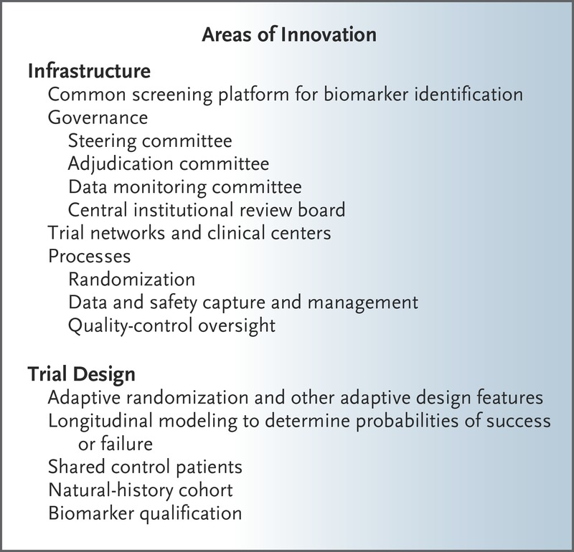
Master Protocol Innovation
Woodcock and LaVange describe the many areas of innovation that can be found in master protocols →

Slide 11
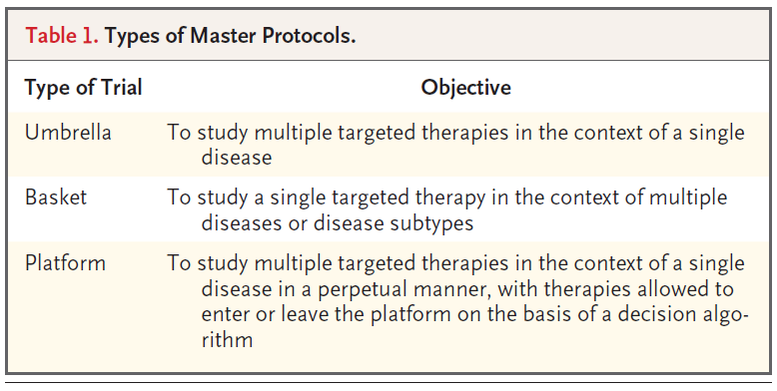
General Classes of Master Protocols

Slide 12
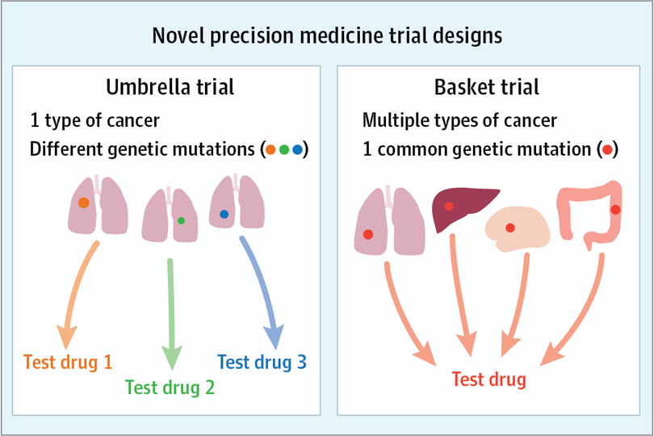
Umbrellas and Baskets
Umbrella trials identify a single (broad) disease, but then further classified by subtypes and treated accordingly
Basket trials identify a common mutation (or trait) across sites and then treat all with a common intervention
Source: West (2017)
Notes:
Image: https://jamanetwork.com/journals/jamaoncology/fullarticle/2591161
West H. Novel Precision Medicine Trial Designs: Umbrellas and Baskets. JAMA Oncol. 2017;3(3):423. doi:10.1001/jamaoncol.2016.5299

Slide 13
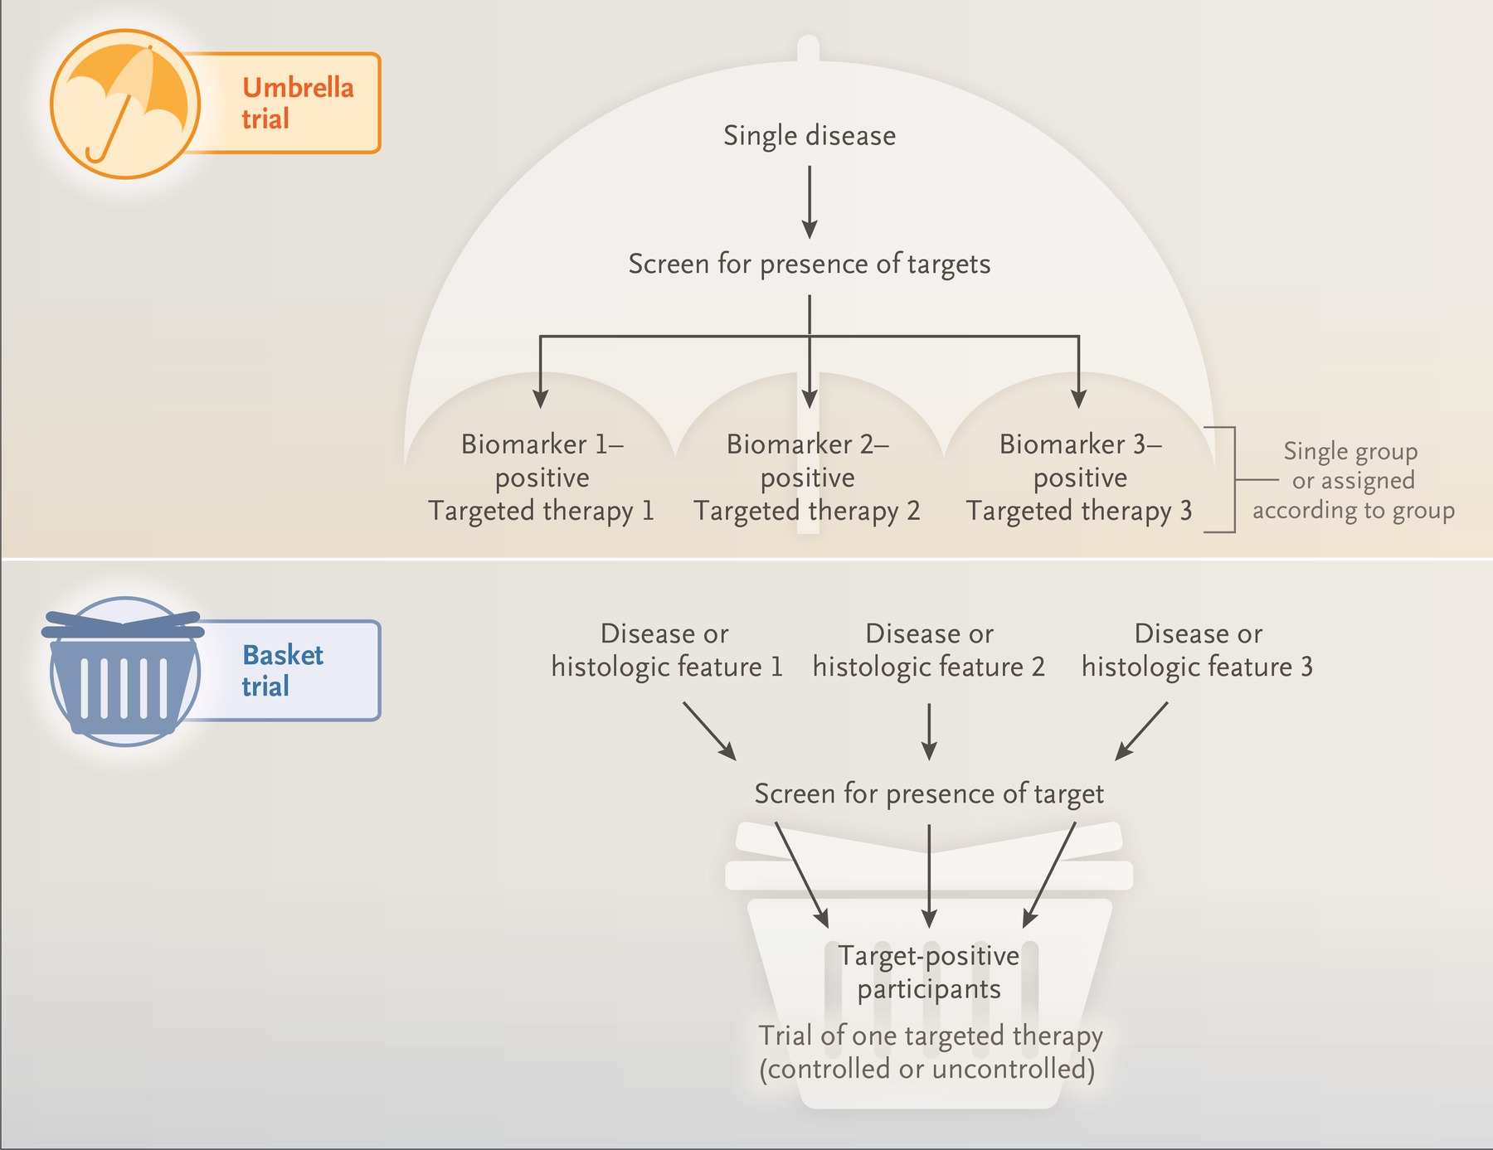
Another example figure of basket and umbrella designs (Figure 1 from Woodcock and LaVange)
Notes:
https://www.nejm.org/doi/full/10.1056/NEJMra1510062

Slide 14
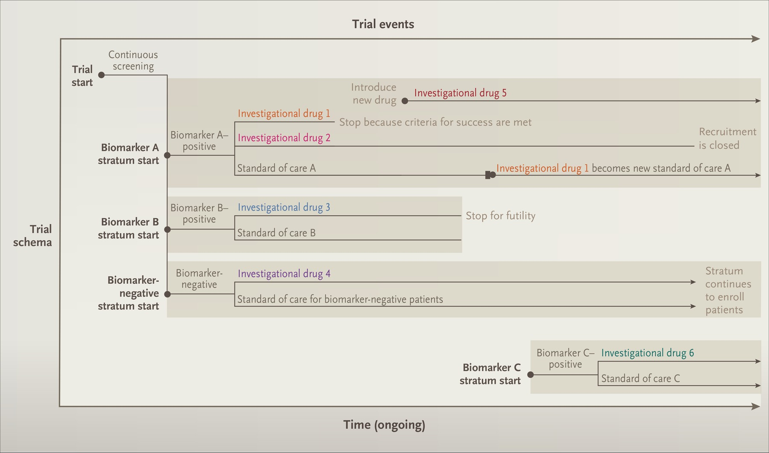
Platform Trials
Platform designs can be very flexible and potentially complex (Figure 2 from Woodcock and LaVange)
Notes:
Image: https://www.nejm.org/doi/full/10.1056/NEJMra1510062

Slide 15
Master Protocols
Designs can be noncomparative or comparative
If comparative, you may have a common control group or multiple control groups depending on design
Designs can include adaptive elements or not
Designs can be exploratory or confirmatory
LOTS of flexibility

Slide 16

Statistical Considerations for Master Protocols
with Motivating Trial & Illustrations via Simulation Studies

Slide 17
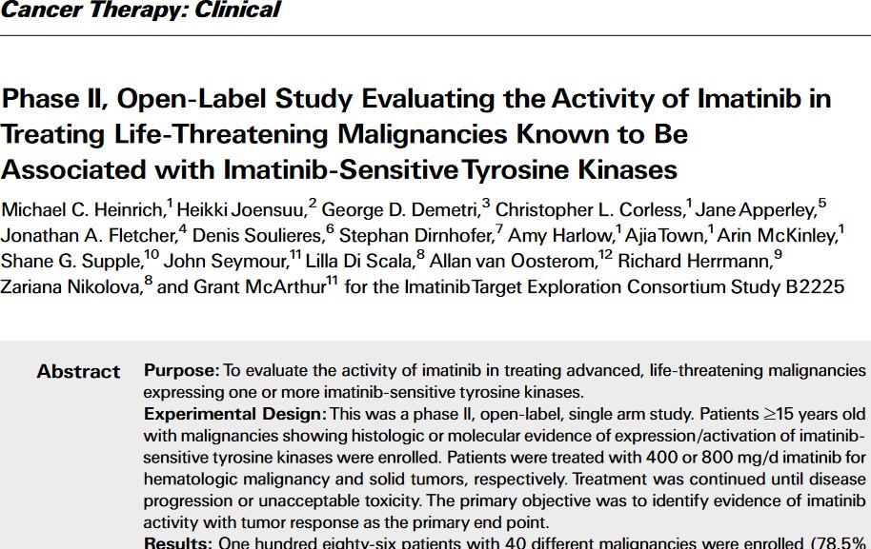
Example Basket Trial
Source: Heinrich et al. (2008)

Slide 18
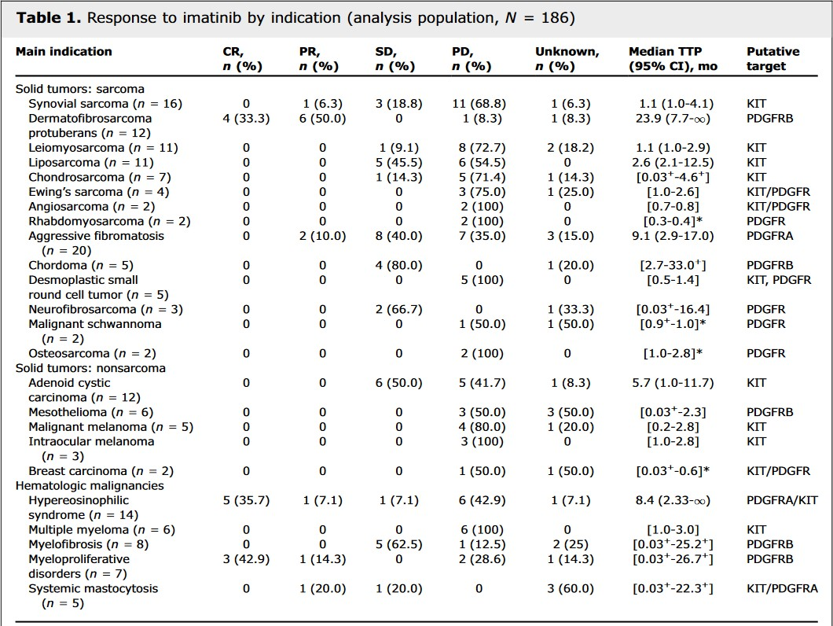
Imatinib Trial Results and Challenges
Often we have small n for each indication
Indication/subgroup heterogeneity is likely (i.e., we might not expect the same result across all baskets)
Operating characteristics, such as power and type I error rates have additional considerations
Depending on the stage of research, we may wish to terminate early for futility and/or efficacy

Slide 19
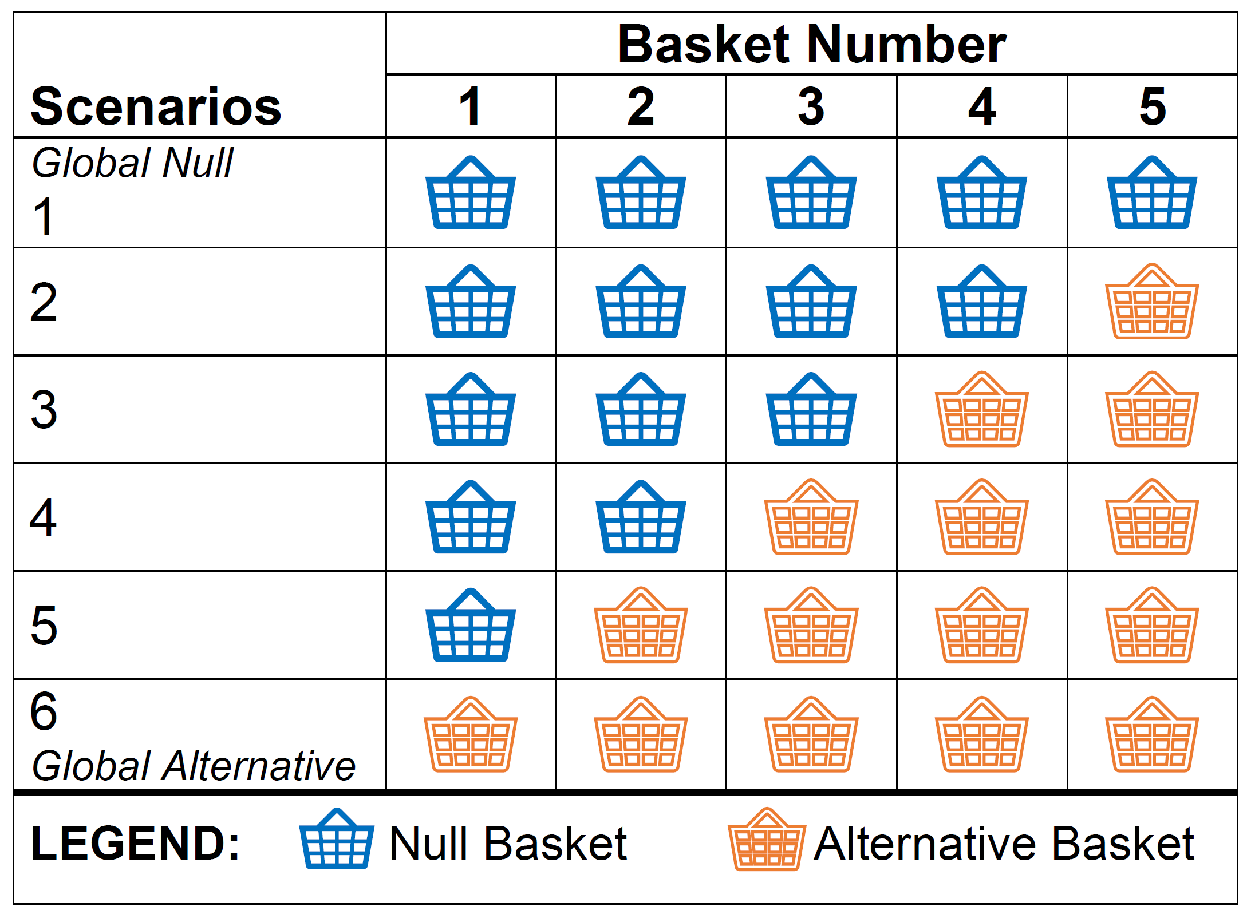
Motivating Example: Trial with 5 Baskets
Assume each basket is either a null or alternative response
Have a total of 6 possible scenarios
Range from completely exchangeable [1 or 6] to meta-subgroups [2-5]

Slide 20
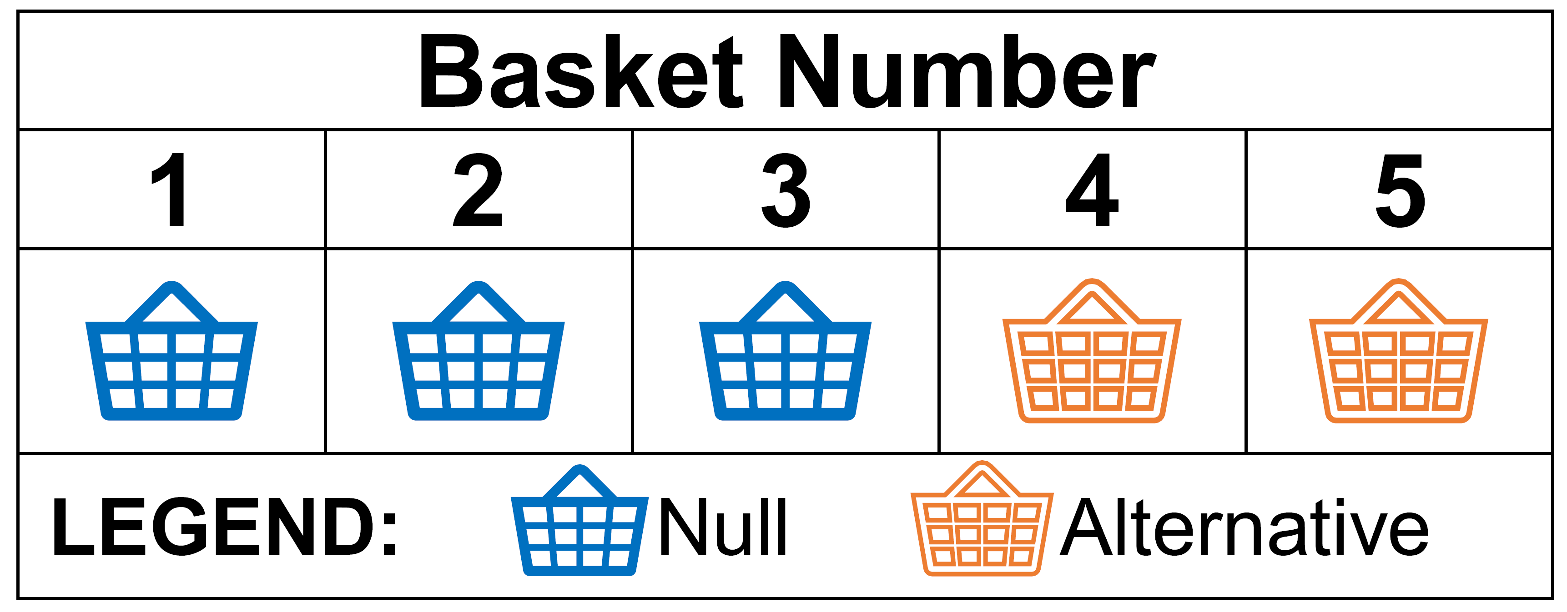
Subgroup Analyses
Pooled (combine all 5 baskets)
Independent (analyze each separately)
Information sharing between baskets (exchangeability; Hobbs and Landin (2018))

Slide 21
Type I Error Rate Calibration
Marginal (basket-specific outcomes)
Family-wise (considering all basket outcomes; even one false conclusion indicates a “failure” of the methods)

Slide 22
Strength of Type I Error Control
Weak (family-wise type I error rate for global null)
Strong (family-wise type I error rate for any scenario)

Slide 23
How to choose the optimal approach?
Optimal model for a basket trial depends upon the context
Often, we pick one scenario in the design stage, but we could encounter any scenario in the future trial
Challenge 1: how to identify the optimal subgroup analysis approach (Kaizer et al., 2019)
Challenge 2: how to a priori identify the optimal hyperparameter values given uncertainty of scenarios (Kaizer et al., 2021)
Challenge 3: how to incorporate interim monitoring (Kaizer et al., 2022)

Slide 24

Optimal Subgroup Analysis Approaches
Challenge 1

Slide 25
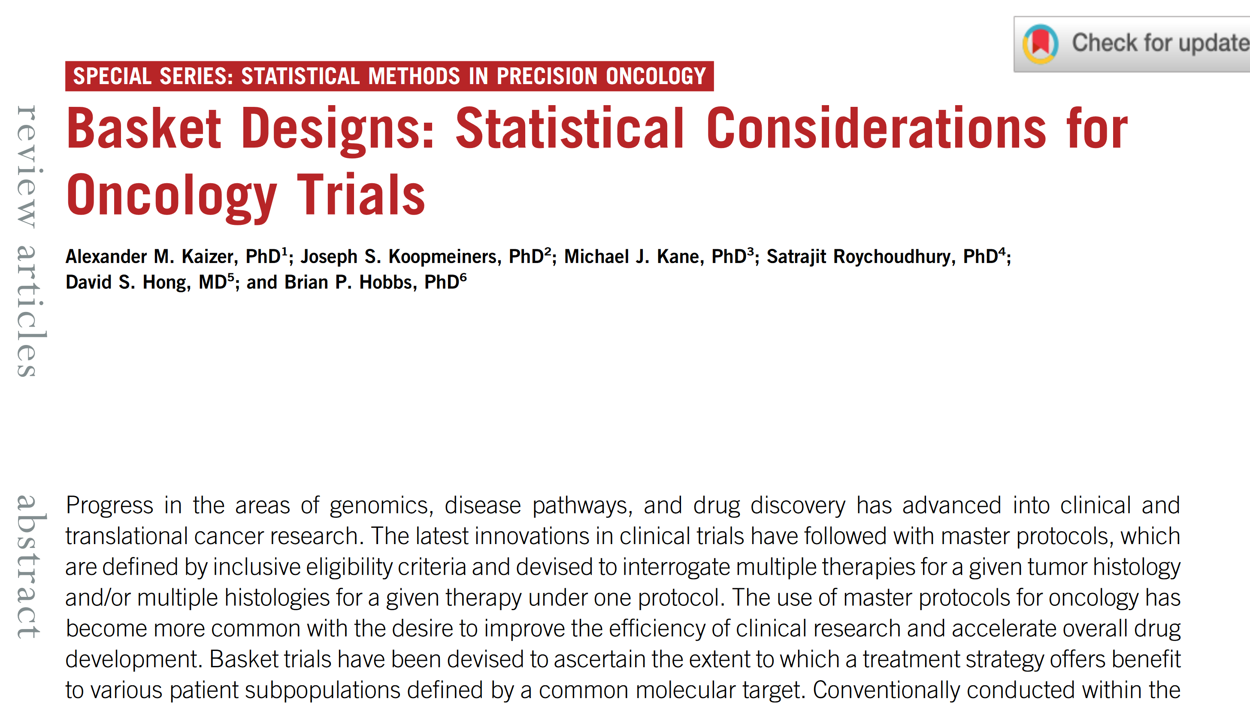

Slide 26
Simulation Study for 5 Basket Trial
Simulate 10,000 fixed-sample trials with 5 baskets each having n=25 for each scenario in R
Assume 10% null response, 30% alternative response
Compare 4 approaches:
Independence with no correction for multiple testing (α=0.1, “Ind”)
Independence with Bonferroni correction (α=0.02, “Mult”)
Pooling all baskets (α=0.1, “Pool”)
Information sharing with multi-source exchangeability models (MEMs) with UB=0.1 hyperparameter
For MEMs, explore posterior probability thresholds calibrated to achieve different targets

Slide 27
Ind Results
# Active Baskets | Ind |  | Mult |  | Pool |  | MEM
 | FT | P | FT | P | FT | P | FT | MT | P
0 | 40 | -
1 | 33 | 91
2 | 26 | 91
3 | 18 | 91
4 | 9 | 91
5 | - | 91
Legend:
FT = Family-wise Type I Error Rate (%)
MT = Marginal Type I Error Rate (%)
P = Power (%)

Slide 28
Mult Results
# Active Baskets | Ind |  | Mult |  | Pool |  | MEM
 | FT | P | FT | P | FT | P | FT | MT | P
0 | 40 | - | 5 | -
1 | 33 | 91 | 4 | 66
2 | 26 | 91 | 3 | 66
3 | 18 | 91 | 2 | 66
4 | 9 | 91 | 1 | 66
5 | - | 91 | - | 66
Legend:
FT = Family-wise Type I Error Rate (%)
MT = Marginal Type I Error Rate (%)
P = Power (%)

Slide 29
Pool Results
# Active Baskets | Ind |  | Mult |  | Pool |  | MEM
 | FT | P | FT | P | FT | P | FT | MT | P
0 | 40 | - | 5 | - | 7 | -
1 | 33 | 91 | 4 | 66 | 48 | 48
2 | 26 | 91 | 3 | 66 | 89 | 89
3 | 18 | 91 | 2 | 66 | 99 | 99
4 | 9 | 91 | 1 | 66 | 100 | 100
5 | - | 91 | - | 66 | - | 100
Legend:
FT = Family-wise Type I Error Rate (%)
MT = Marginal Type I Error Rate (%)
P = Power (%)

Slide 30
MEM with PP=86.25% Threshold Results
# Active Baskets | Ind |  | Mult |  | Pool |  | MEM
 | FT | P | FT | P | FT | P | FT | MT | P
0 | 40 | - | 5 | - | 7 | - | 40 | 10 | -
1 | 33 | 91 | 4 | 66 | 48 | 48 | 34 | 11 | 91
2 | 26 | 91 | 3 | 66 | 89 | 89 | 31 | 14 | 92
3 | 18 | 91 | 2 | 66 | 99 | 99 | 33 | 20 | 93
4 | 9 | 91 | 1 | 66 | 100 | 100 | 23 | 23 | 95
5 | - | 91 | - | 66 | - | 100 | - | - | 96
Legend:
FT = Family-wise Type I Error Rate (%)
MT = Marginal Type I Error Rate (%)
P = Power (%)

Slide 31
MEM with PP=89.75% Threshold Results
# Active Baskets | Ind |  | Mult |  | Pool |  | MEM
 | FT | P | FT | P | FT | P | FT | MT | P
0 | 40 | - | 5 | - | 7 | - | 34 | 8 | -
1 | 33 | 91 | 4 | 66 | 48 | 48 | 31 | 9 | 89
2 | 26 | 91 | 3 | 66 | 89 | 89 | 26 | 9 | 91
3 | 18 | 91 | 2 | 66 | 99 | 99 | 18 | 9 | 91
4 | 9 | 91 | 1 | 66 | 100 | 100 | 9 | 9 | 91
5 | - | 91 | - | 66 | - | 100 | - | - | 91
Legend:
FT = Family-wise Type I Error Rate (%)
MT = Marginal Type I Error Rate (%)
P = Power (%)

Slide 32
MEM with PP=97.15% Threshold Results
# Active Baskets | Ind |  | Mult |  | Pool |  | MEM
 | FT | P | FT | P | FT | P | FT | MT | P
0 | 40 | - | 5 | - | 7 | - | 10 | 2 | -
1 | 33 | 91 | 4 | 66 | 48 | 48 | 10 | 3 | 74
2 | 26 | 91 | 3 | 66 | 89 | 89 | 9 | 3 | 78
3 | 18 | 91 | 2 | 66 | 99 | 99 | 6 | 3 | 80
4 | 9 | 91 | 1 | 66 | 100 | 100 | 3 | 3 | 81
5 | - | 91 | - | 66 | - | 100 | - | - | 81
Legend:
FT = Family-wise Type I Error Rate (%)
MT = Marginal Type I Error Rate (%)
P = Power (%)

Slide 33
MEM Comparisons
Legend:
FT = Family-wise Type I Error Rate (%)
MT = Marginal Type I Error Rate (%)
P = Power (%)
# Active Baskets | MEM 86.25% |  |  | MEM 89.75% |  |  | MEM 97.15%
 | FT | MT | P | FT | MT | P | FT | MT | P
0 | 40 | 10 | - | 34 | 8 | - | 10 | 2 | -
1 | 34 | 11 | 91 | 31 | 9 | 89 | 10 | 3 | 74
2 | 31 | 14 | 92 | 26 | 9 | 91 | 9 | 3 | 78
3 | 33 | 20 | 93 | 18 | 9 | 91 | 6 | 3 | 80
4 | 23 | 23 | 95 | 9 | 9 | 91 | 3 | 3 | 81
5 | - | - | 96 | - | - | 91 | - | - | 81
Simply changing the PP threshold leads to very different results! Different thresholds for different contexts!
PP Threshold of 86.25% controls global null MT1E and maximizes power.
PP Threshold of 89.75% controls all null MT1E with ~90% power for all scenarios.
PP Threshold of 97.15% controls FT1E and but has low MT1E and lower power (but still ~80%).

Slide 34
Subgroup Conclusions
Methods perform very different depending upon the given scenario
The posterior probability thresholds for MEMs can be calibrated to achieve different performance across scenarios
Choice of subgroup approach will depend upon context:
Phase II may be more exploratory (e.g., controlling marginal T1E rates and allowing information sharing)
Phase III is confirmatory (e.g., controlling family-wise T1E rates, potentially allowing information sharing)

Slide 35
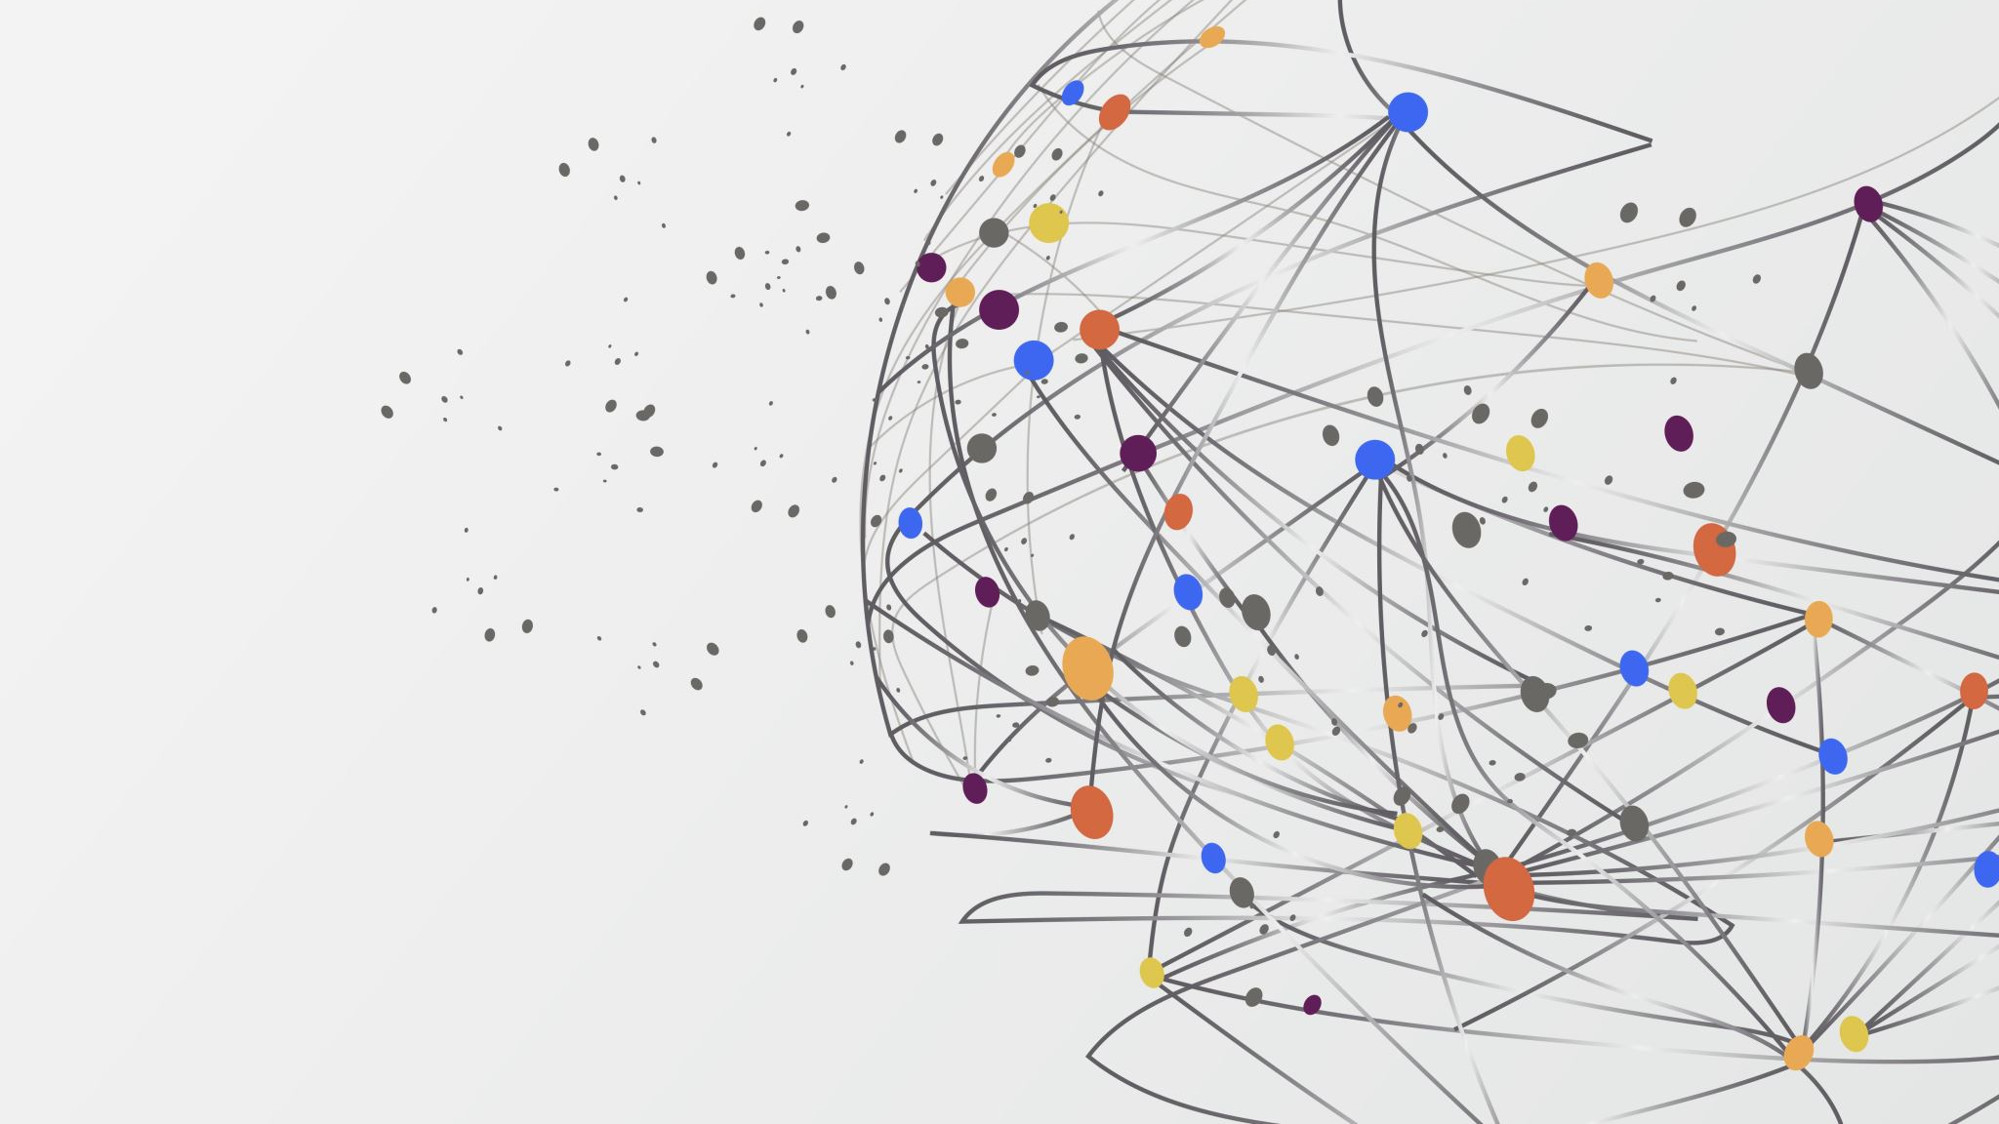
Interim Monitoring in Basket Trials
Challenge 3

Slide 36


Slide 37
Why Futility Interim Monitoring?
Economical: desire to drop poorly performing baskets early to re-allocate or save resources from being spent on futile treatment
Ethical: closing a basket allows those patients to enroll in trials with different treatments that may work for them
Practical: it may be easier to conduct and continue a trial with fewer baskets
Could also stop for efficacy, but less common in Phase II (basket) trials

Slide 38
Simon Two-Stage Design
One of the most popular futility designs in oncology
Allows one interim look for futility after stage one to either minimize the maximum sample size (minimax) or the expected sample size (optimal)
For a minimax design with α=0.1, 90% power, p₀=0.1, p₁=0.3:
[Stage 1] Enroll 16, terminate for futility if <1 responses.
[Stage 2] Continue enrollment to 25 total, if <4 responses no further investigation is warranted.

Slide 39
Potential Limitations to Simon’s Two-Stage Design for Basket Trials
It is restrictive in when it may terminate and may continue to the maximum sample size even if a null effect is present.
Solution: Consider using Bayesian methods for more frequent interim monitoring (e.g., posterior and/or predictive probabilities).
For designs with multiple indications, it fails to take advantage of potential exchangeability across baskets/arms.
Solution: Examine use of multi-source exchangeability models to share information across baskets when appropriate.

Slide 40
Posterior and Predictive Probabilities
Consideration of Bayesian interim stopping rules has been extensively examined (Dmitrienko and Wang, 2006; Saville et al., 2014). We will consider two methods for evaluating significance:
Posterior Probability: Based on our posterior distribution, the probability that the proportion exceeds our null response rate of p₀ = 0.1.
Predictive Probability: Considering our accumulated data and prior(s), the probability that we will have a significant result at our maximum planned sample size.

Slide 41
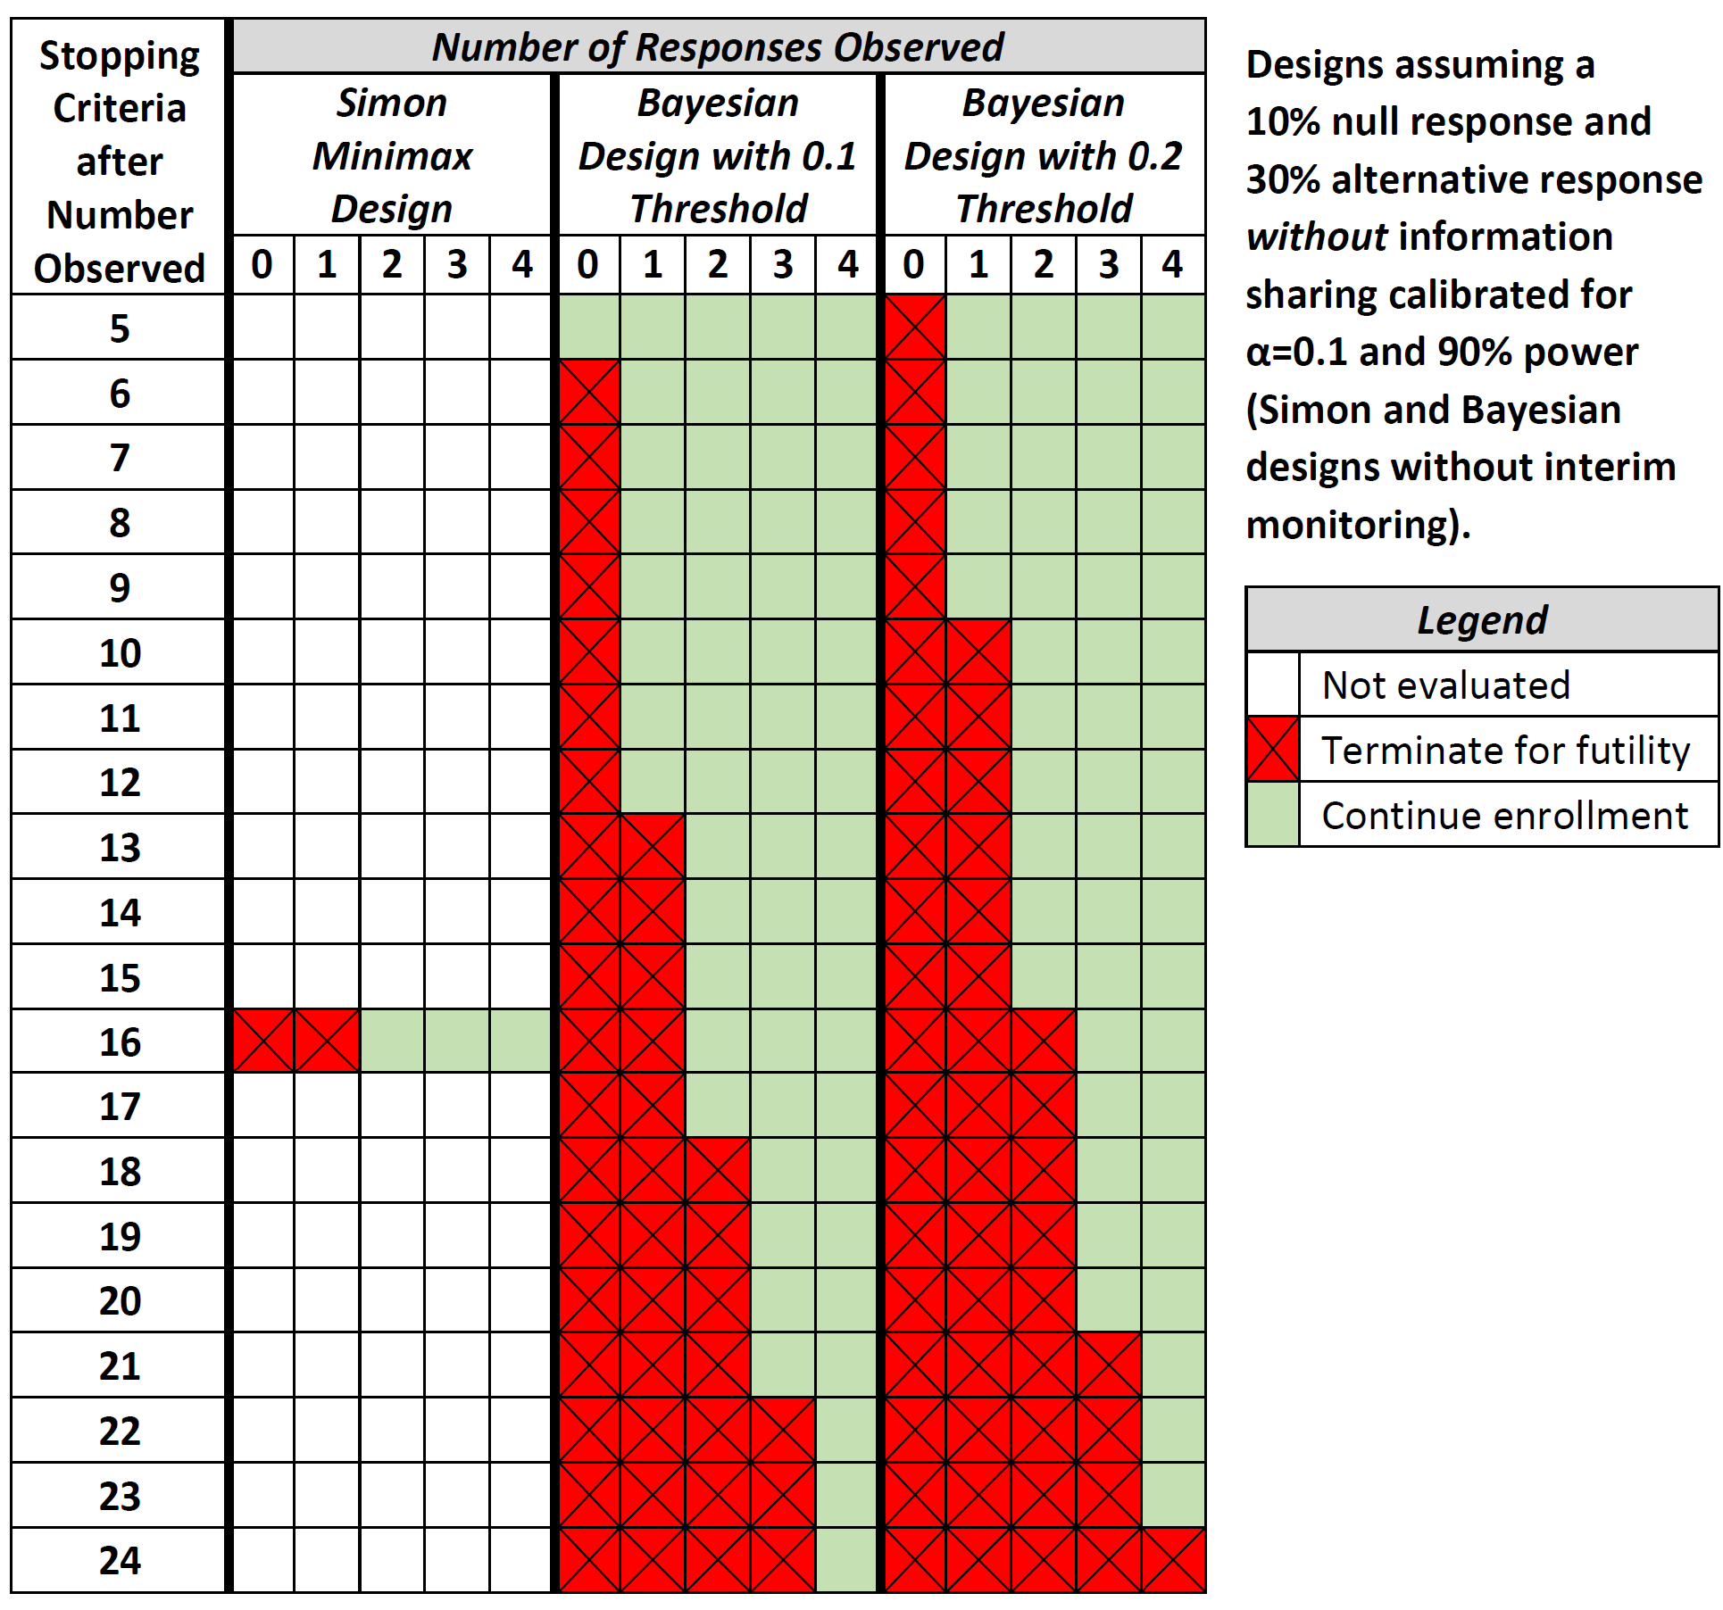
Both approaches can result in an “easy-to-use” graphical guide for stopping criteria.

Slide 42
Simulation Set-Up
Assume a 10 basket trial where p₀=0.1 and p₁=0.3
Generate 1,000 trials with N=25 per basket under two scenarios:
Global scenario (all null or all alternative baskets)
Mixed scenario (8 null and 2 alternative baskets)
Compare three designs:
Simon minimax two-stage design
Bayesian design with predictive probability monitoring without information sharing (i.e., MEM prior hyperparameter B=0)
Bayesian design with information sharing via MEMs set at B=0.1

Slide 43
Bayesian Calibration and Monitoring
Assume a Beta(0.5,0.5) prior on treatment response.
Posterior probability thresholds calibrated to achieve a 10% T1E rate under the global null scenario with N=25 and no interim monitoring:
When B=0, conclude “success” if PP>0.900
When B=0.1, conclude “success” if PP>0.848
Predictive probability monitoring for futility is implemented continually after the 5th participant in each basket.
Explore thresholds across grid of values from 0 to 0.5 in increments of 0.05

Slide 44
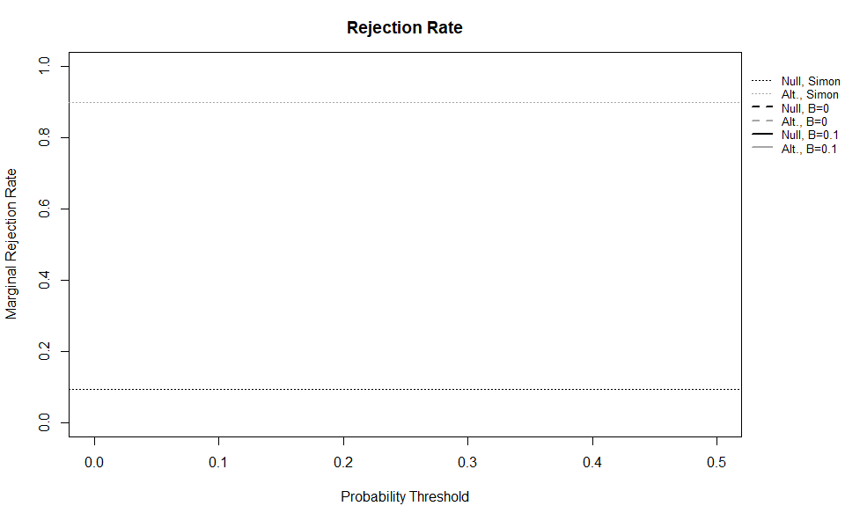
Global Scenario Results

Slide 45
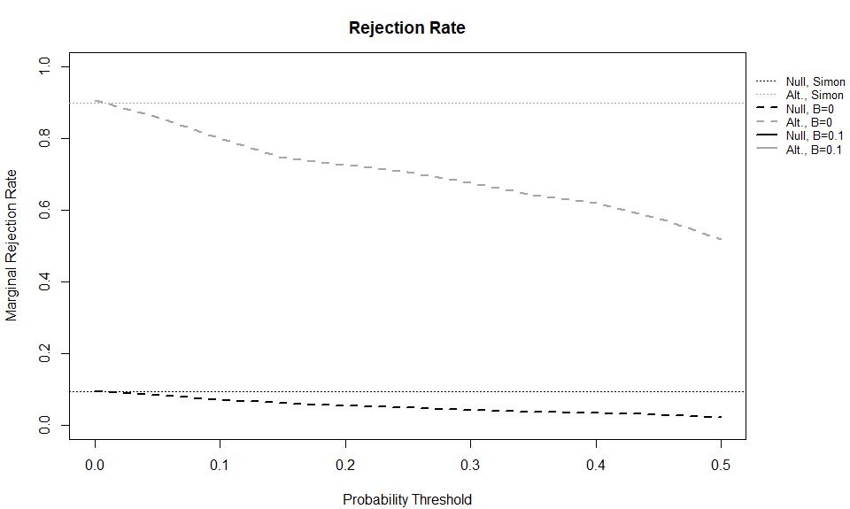
Global Scenario Results

Slide 46
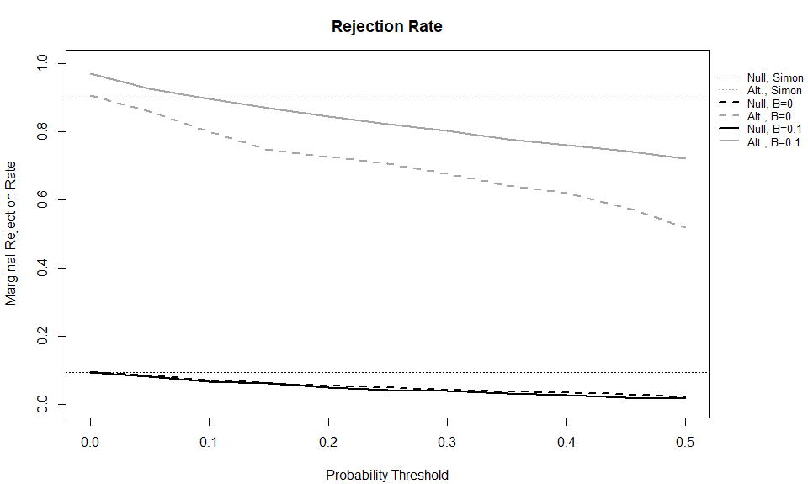
Global Scenario Results

Slide 47

Global Scenario Results

Slide 48
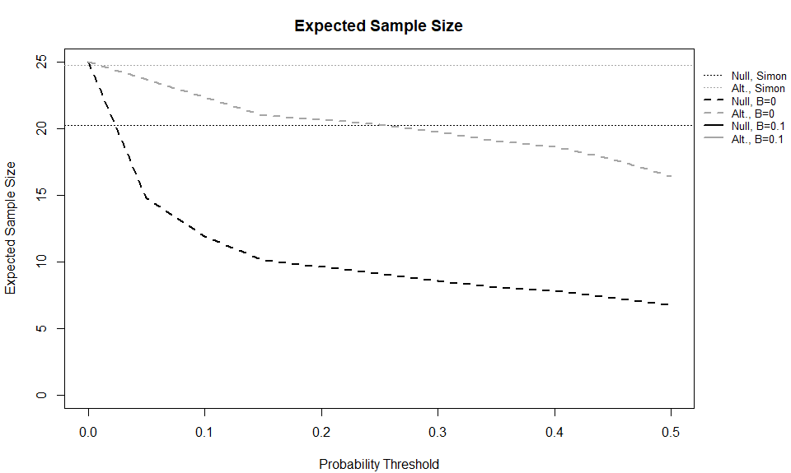
Global Scenario Results

Slide 49
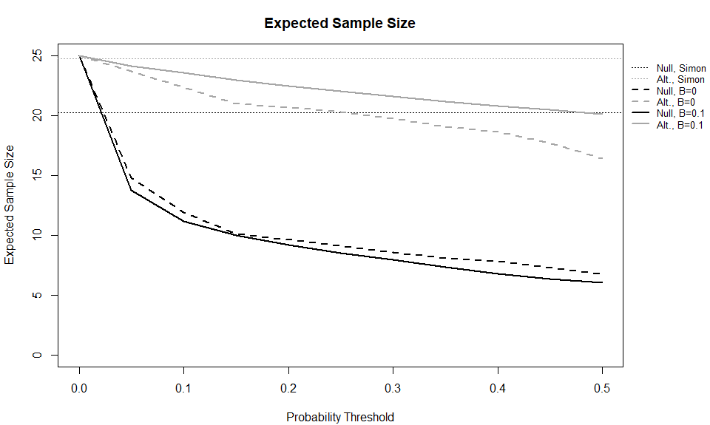
Global Scenario Results

Slide 50
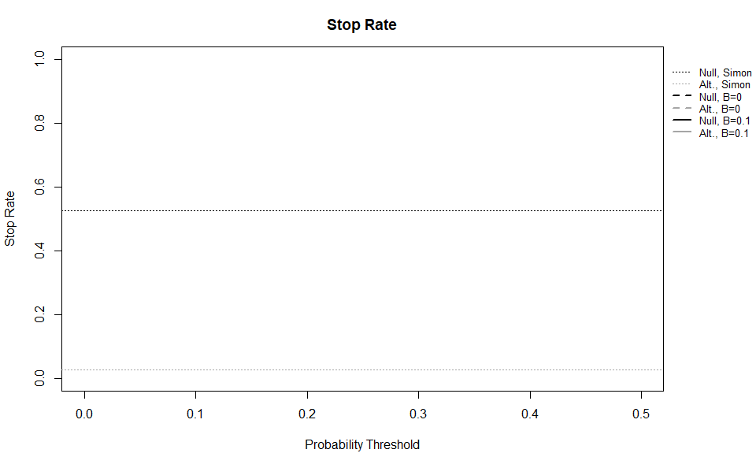
Global Scenario Results

Slide 51
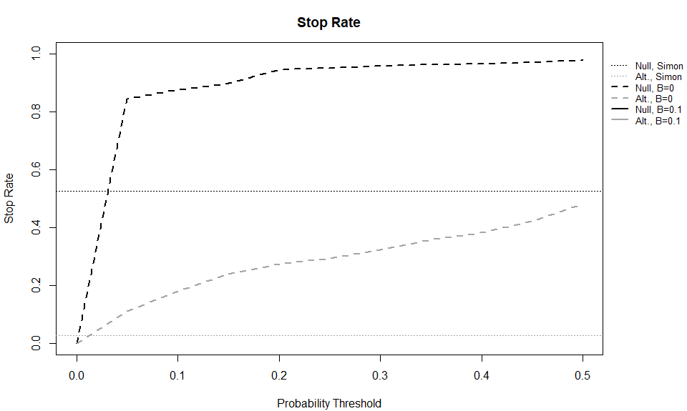
Global Scenario Results

Slide 52
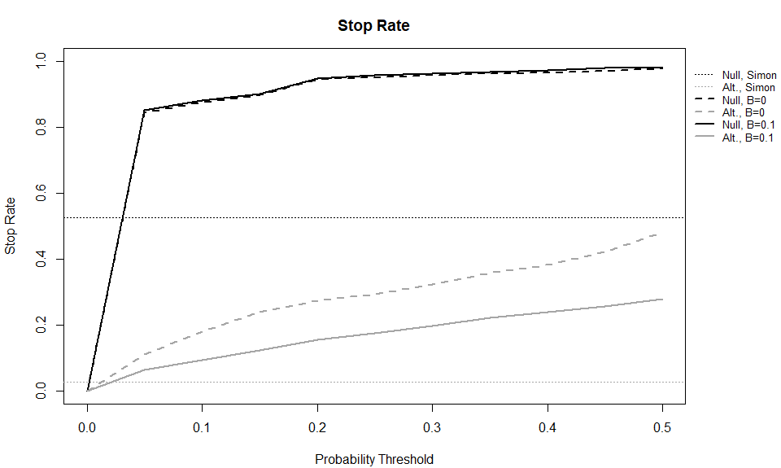
Global Scenario Results

Slide 53
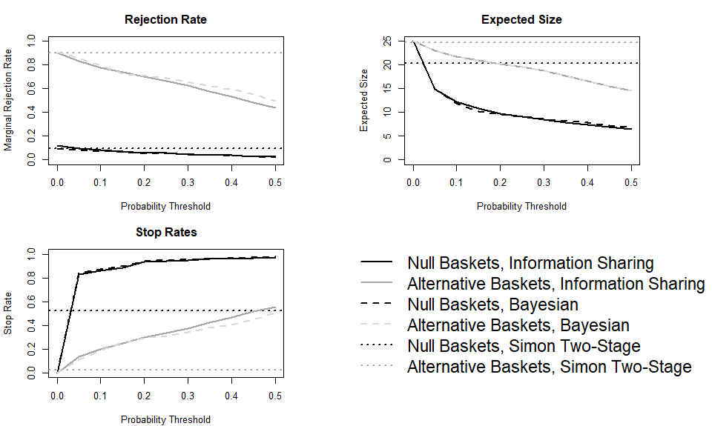
Previous results were for the global scenario, here we present the same figures for the mixed scenario with 8 null baskets and 2 alternative baskets.
Notice, MEMs are very similar to Bayesian design with no borrowing (but continual interim monitoring).
Mixed Scenario Results

Slide 54
Interim Monitoring Conclusions
The Simon two-stage design is inefficient with respect to many trial operating characteristics, but simple to implement
Predictive probability monitoring can lead to a much lower expected sample size with only slightly lower power (when we calibrate our designs for no interim monitoring and look after every participant)
Information sharing with MEMs can increase power in the global scenario, but should be calibrated for other scenarios if expected (use Challenge 2 methods from SMMR paper (Kaizer (2021)); calibrate for mixed scenario directly)

Slide 55

Contact Info:
Emails:
alex.kaizer@cuanschutz.edu
brian.hobbs@austin.utexas.edu
Website: www.alexkaizer.com
GitHub: alexbiostats

Slide 56
Select References
Dmitrienko, A., Tamhane, A. C., and Bretz, F. (2009). Multiple testing problems in pharmaceutical statistics. CRC press.
Dmitrienko, A. and Wang, M.-D. (2006). Bayesian predictive approach to interim monitoring in clinical trials. Statistics in medicine, 25(13):2178–2195.
Heinrich, M. C., Joensuu, H., Demetri, G. D., Corless, C. L., Apperley, J., Fletcher, J. A., Soulieres, D., Dirnhofer, S., Harlow, A., Town, A., et al. (2008). Phase ii, open-label study evaluating the activity of imatinib in treating life-threatening malignancies known to be associated with imatinib-sensitive tyrosine kinases. Clinical Cancer Research, 14(9):2717–2725.
Hobbs, B., Kane, M., Hong, D., and Landin, R. (2018). Statistical challenges posed by uncontrolled master protocols: sensitivity analysis of the vemurafenib study. Annals of Oncology.
Hobbs, B. P. and Landin, R. (2018). Bayesian basket trial design with exchangeability monitoring. Statistics in medicine.
Hyman, D. M., Piha-Paul, S. A., Won, H., Rodon, J., Saura, C., Shapiro, G. I., Juric, D., Quinn, D. I., Moreno, V., Doger, B., et al. (2018). Her kinase inhibition in patients with her2-and her3-mutant cancers. Nature, 554(7691):189–194.

Slide 57
Select References
Kaizer, A., Zabor, E., Nie, L., and Hobbs, B. (2022). Bayesian and frequentist approaches to sequential monitoring for futility in oncology basket trials: A comparison of simon’s two-stage design and bayesian predictive probability monitoring with information sharing across baskets. Plos one, 17(8):e0272367.
Kaizer, A. M., Koopmeiners, J. S., Chen, N., and Hobbs, B. P. (2021). Statistical design considerations for trials that study multiple indications. Statistical Methods in Medical Research, 30(3):785–798. PMID: 33267746.
Kaizer, A. M., Koopmeiners, J. S., Kane, M. J., Roychoudhury, S., Hong, D. S., and Hobbs, B. P. (2019). Basket designs: Statistical considerations for oncology trials. JCO Precision Oncology, 3:1–9.
Saville, B. R., Connor, J. T., Ayers, G. D., and Alvarez, J. (2014). The utility of bayesian predictive probabilities for interim monitoring of clinical trials. Clinical Trials, 11(4):485–493.
Woodcock, J. and LaVange, L. M. (2017). Master protocols to study multiple therapies, multiple diseases, or both. New England Journal of Medicine, 377(1):62–70.
Zabor, E. C., Kane, M. J., Roychoudhury, S., Nie, L., and Hobbs, B. P. (2022). Bayesian basket trial design with false-discovery rate control. Clinical Trials, page 17407745211073624.

